Slide 1
How to Use this Presentation
Present with ease and wow your audience
Customize with text and photos.
Add elements from the library or upload from your drive. Apply page animations and transitions to emphasize ideas.
Use point forms and short sentences instate of long paragraphs Use the PLP pitch deck guide and follow the protocol on slides
Lastly “PLEASE DELETE THIS SLIDE WHEN YOU ARE DONE!”
02

Slide 2

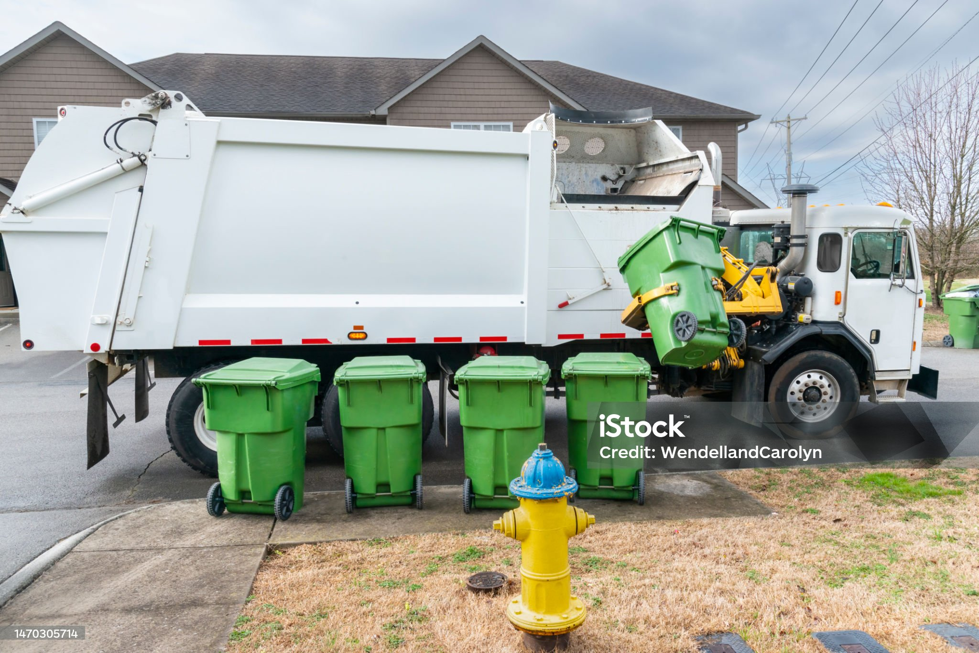
Eco Track
Revolutionizing Waste Management with Smart Technology
01

Slide 3
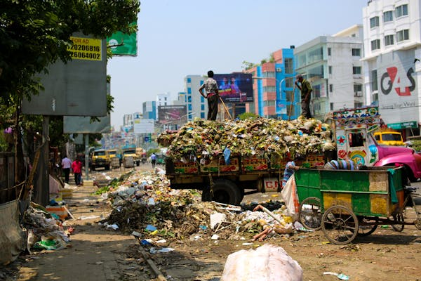
Problem
Urban solid waste is rising fast, but poor tracking and limited municipal resources leave much uncollected, harming health and the environment.
Our solution aims to address both the inefficiencies in waste tracking and the gaps in resource provision such as vehicles, operators, and logistics to streamline and strengthen urban waste management systems.
10

Slide 4
Solution
Real-Time Waste Tracking--Uses GPS and IoT-enabled devices to monitor waste levels in bins and containers.
Optimized Route Planning--Integrates smart algorithms to reduce fuel use, time, and labor by identifying the most efficient collection routes.
Resource Management Dashboard--Tracks vehicle availability, maintenance needs, and operator assignments.
Data-Driven Decision Making--Provides analytics on waste generation patterns by area, time, and type.
Community Integration--Mobile app or SMS alerts to notify residents of collection schedules or delays.
Enhances collaboration between municipal departments and private waste operators through shared data and scheduling tools.
Environmental and Public Health Benefits--Minimizes exposure to waste-related health risks and improves neighborhood cleanliness.
06

Slide 5
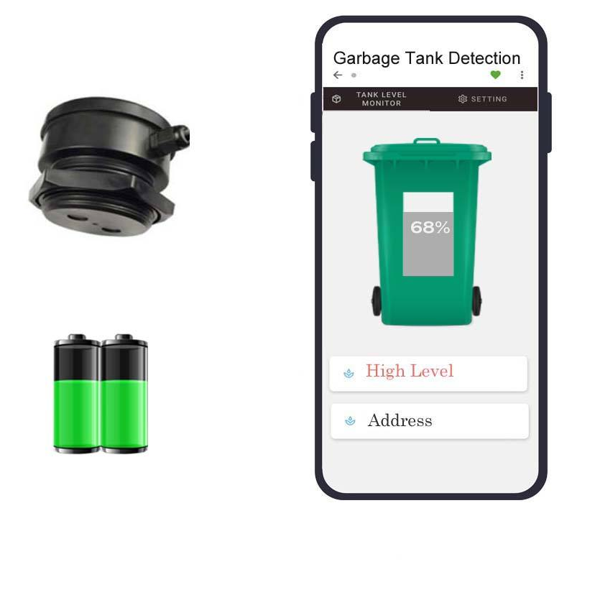
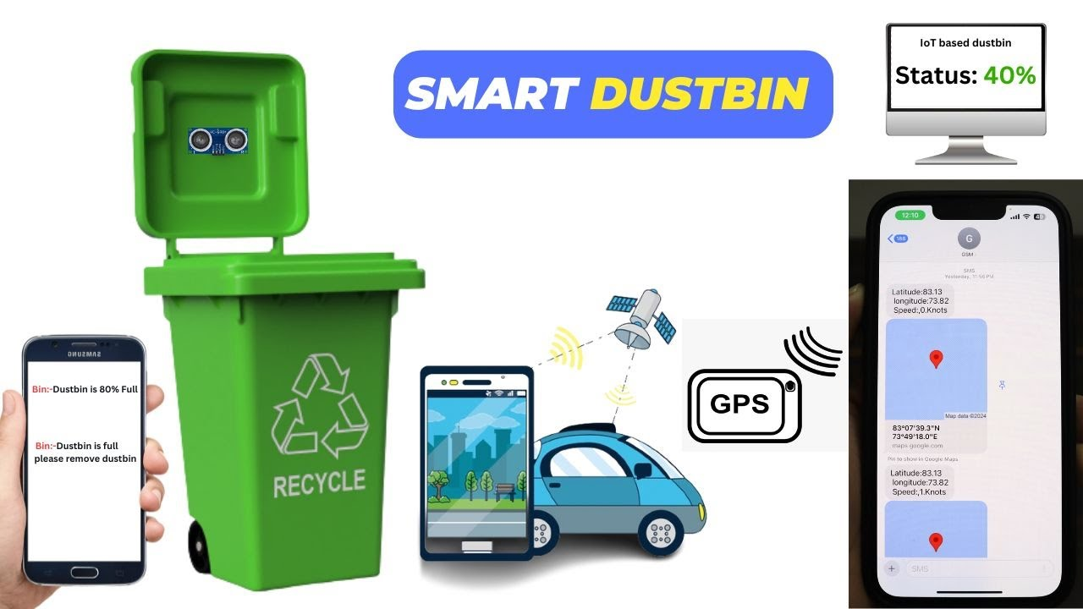
Product
Community data dashboards
Recycler connection
GPS-enabled smart bins
04

Slide 6
3 out 5
3/5 households lack regular collection.
Target Market
50%
• Less than 50% of generated waste is collected, and a substantial amount is disposed of through burning, burying, or haphazardly into the environment.
12.1-17.4 million
• Tanzania generates a large amount of solid waste, estimated at 12.1-17.4 million tonnes per year.
14

Slide 7
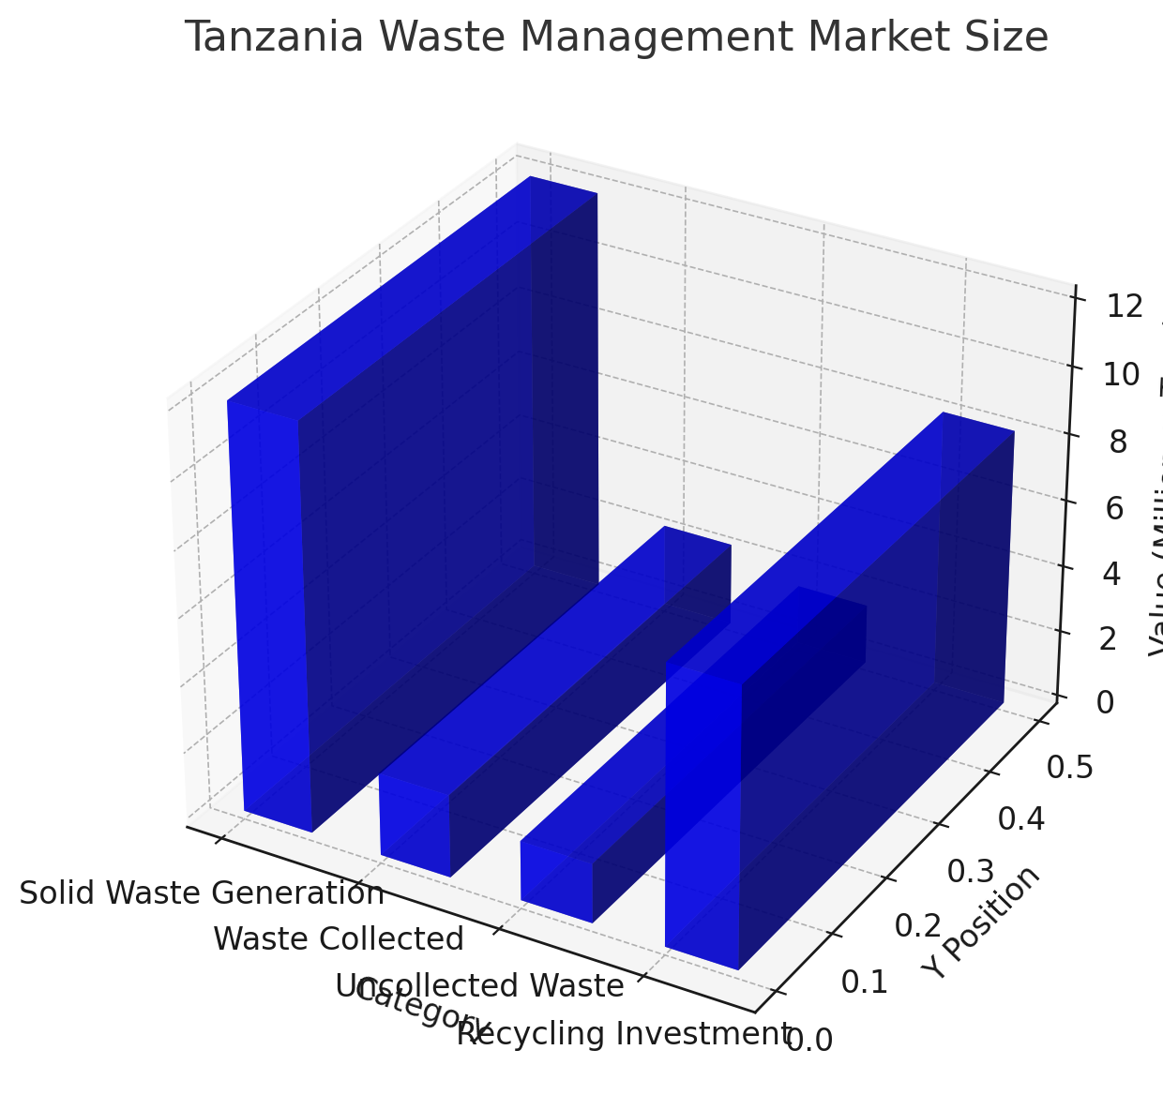
Market Size
The primary audience and beneficiaries of the Echo-Track Solution.
Tanzanian waste management market presents a substantial opportunity, with an estimated potential investment of USD 8.3 million in recycling alone. Tanzania generates a significant volume of waste, example Dar es Salaam City alone producing around 4,252 tons of solid waste daily, though only about 2,473 tons are collected.
This highlights a significant gap in waste management infrastructure and a large market opportunity for companies specializing in waste collection, sorting, recycling, and disposal.
Urban households
20%
Recyclers
20%
Municipal councils
20%
NGOs 20%
Waste Collection Vendors
20%

Slide 8
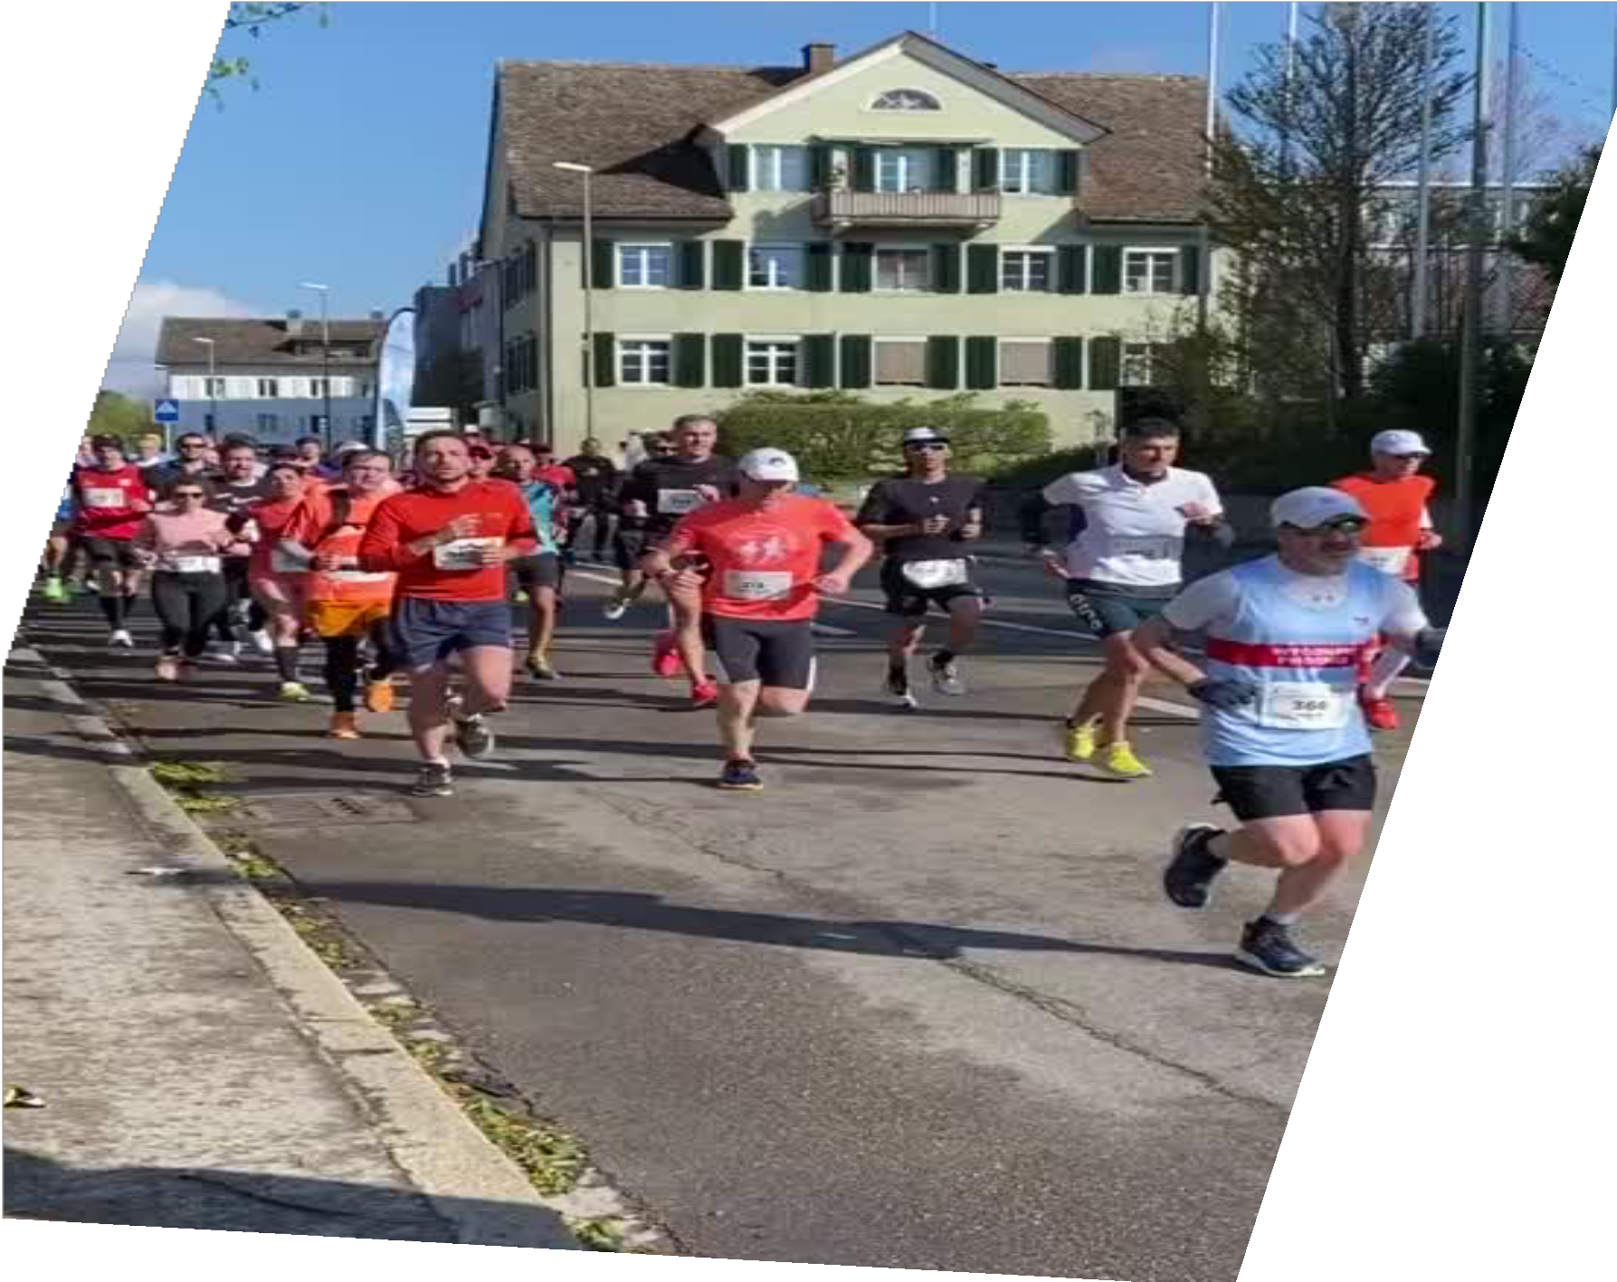
Competitors
• Green WastePro Ltd-- private company that specializes in waste management.
• The Recycler -- private company that offers waste management and recycling solutions in Tanzania.
• TMHS -- specializes in hazardous waste management.
23

Slide 9
Competitive Advantage
• Real-time data
• Predictive scheduling
• User rewards
• First-mover in many regions

Slide 10
Project Traction
Tasks
Month 1
Month 2
Month 3
Month 4-5
Month 6
Pilot Implementation
Partner with recyclers
App Launch and Smart Bin Deployment
Dashboard Launch
23

Slide 11
Business Model
• Municipal subscriptions
• Recycler commission
• Analytics services
23

Slide 12
Go To Market
Local influencer outreach
Demos to municipalities
Government collaborations

Slide 13
Social Impact
SDG 11: Sustainable Cities
SDG 12: Responsible Use
SDG 13: Climate Action

Slide 14
Our Ask
$75,000 for tech development and pilot deployment
Technology Development – $40,000
This portion covers the design, development, and testing of the Echo-Track system
Pilot Deployment – $35,000
This covers real-world testing of the solution in a selected urban area.
Item | Description | Estimated Cost
Software Development | Design and build the waste tracking platform (dashboard, backend system, and API) | $18,000
Mobile App Development | Android/iOS app for operators and residents (tracking, alerts, reporting) | $10,000
IoT Device Integration | Integrate smart sensors for waste bins and collection vehicles | $7,000
System Testing & QA | Ensure platform functionality, security, and reliability | $3,000
Cloud Hosting & Data Storage | Server setup and data infrastructure (first-year cost) | $2,000
Item | Description | Estimated Cost
Sensor Hardware & Installation | GPS trackers and waste bin sensors for 50+ units | $12,000
Vehicle Integration & Upgrades | Equip 5-10 waste collection trucks with tracking systems | $6,000
Personnel & Training | Train municipal staff and waste operators on system use | $5,000
Marketing & Community Awareness | Materials, campaigns, and workshops to onboard households | $4,000
Monitoring & Evaluation | Field assessment, data collection, and reporting | $4,000
Contingency (10%) | Unexpected operational or technical costs | $4,000

Slide 15

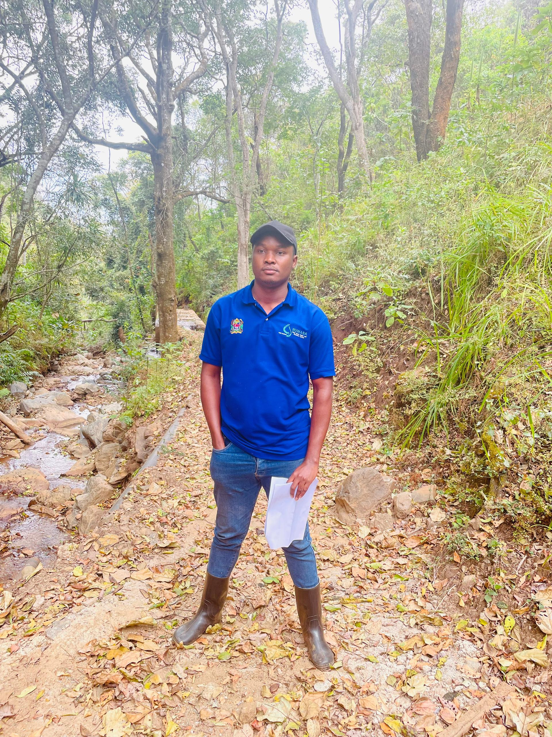
Team Members
LUTFIA MOSI
OBADIA SAMA
Ops Lead& Developer
Community Liaison & Data Scientist

Slide 16
Thank you!
Email | lutfikhatib112@gmail.com
Phone | +255 656 936 620
@EcoTrack
17

